Slide 1
Preaching Colossians: Chapter 4—Final Instructions and Greetings Prof. Barry McCarty SWBTS School of Preaching

Slide 2
Paragraph
Sentences
Main Clauses
Phrases
Words
Dependent Clauses

Slide 3
ESV
Further Instructions
² Continue steadfastly in prayer, being watchful in it with thanksgiving. 3 At the same time, pray also for us, that God may open to us a door for the word, to declare the mystery of Christ, on account of which I am in prison— ⁴ that I may make it clear, which is how I ought to speak.
⁵ Walk in wisdom toward outsiders, making the best use of the time. ⁶ Let your speech always be gracious, seasoned with salt, so that you may know how you ought to answer each person.
Final Greetings
⁷ Tychicus will tell you all about my activities. He is a beloved brother and faithful minister and fellow servant in the Lord. ⁸ I have sent him to you for this very purpose, that you may know how we are and that he may encourage your hearts, ⁹ and with him Onesimus, our faithful and beloved brother, who is one of you. They will tell you of everything that has taken place here.
¹⁰ Aristarchus my fellow prisoner greets you, and Mark the cousin of Barnabas (concerning whom you have received instructions—if he comes to you, welcome him), ¹¹ and Jesus who is called Justus. These are the only men of the circumcision among my fellow workers for the kingdom of God, and they have been a comfort to me. ¹² Epaphras, who is one of you, a servant of Christ Jesus, greets you, always struggling on your behalf in his prayers, that you may stand mature and fully assured in all the will of God. ¹³ For I bear him witness that he has worked hard for you and for those in Laodicea and in Hierapolis. ¹⁴ Luke the beloved physician greets you, as does Demas. ¹⁵ Give my greetings to the brothers at Laodicea, and to Nympha and the church in her house. ¹⁶ And when this letter has been read among you, have it also read in the church of the Laodiceans; and see that you also read the letter from Laodicea. ¹⁷ And say to Archippus, “See that you fulfill the ministry that you have received in the Lord.”
¹⁸ I, Paul, write this greeting with my own hand. Remember my chains. Grace be with you.
Nestle-Aland Greek NT
² Τῇ προσευχῇ προσκαρτερεῖτε, γρηγοροῦντες ἐν αὐτῇ ἐν εὐχαριστίᾳ, ³ προσευχόμενοι ἅμα καὶ περὶ ἡμῶν, ἵνα ὁ θεὸς ἀνοίξῃ ἡμῖν θύραν τοῦ λόγου λαλῆσαι τὸ μυστήριον τοῦ Χριστοῦ, διʼ ὃ καὶ δέδεμαι, ⁴ ἵνα φανερώσω αὐτὸ ὡς δεῖ με λαλῆσαι. ⁵ Ἐν σοφίᾳ περιπατεῖτε πρὸς τοὺς ἔξω τὸν καιρὸν ἐξαγοραζόμενοι. ⁶ ὁ λόγος ὑμῶν πάντοτε ἐν χάριτι, ἅλατι ἠρτυμένος, εἰδέναι πῶς δεῖ ὑμᾶς ἑνὶ ἑκάστῳ ἀποκρίνεσθαι.
⁷ Τὰ κατʼ ἐμὲ πάντα γνωρίσει ὑμῖν Τυχικὸς ὁ ἀγαπητὸς ἀδελφὸς καὶ πιστὸς διάκονος καὶ σύνδουλος ἐν κυρίῳ, 8 ὃν ἔπεμψα πρὸς ὑμᾶς εἰς αὐτὸ τοῦτο, ἵνα γνῶτε τὰ περὶ ἡμῶν καὶ παρακαλέσῃ τὰς καρδίας ὑμῶν, ⁹ σὺν Ὀνησίμῳ τῷ πιστῷ καὶ ἀγαπητῷ ἀδελφῷ, ὅς ἐστιν ἐξ ὑμῶν· πάντα ὑμῖν γνωρίσουσιν τὰ ὧδε.
¹⁰ Ἀσπάζεται ὑμᾶς Ἀρίσταρχος ὁ συναιχμάλωτός μου καὶ Μᾶρκος ὁ ἀνεψιὸς Βαρναβᾶ (περὶ οὗ ἐλάβετε ἐντολάς, ἐὰν ἔλθῃ πρὸς ὑμᾶς, δέξασθε αὐτόν) ¹¹ καὶ Ἰησοῦς ὁ λεγόμενος Ἰοῦστος, οἱ ὄντες ἐκ περιτομῆς, οὗτοι μόνοι συνεργοὶ εἰς τὴν βασιλείαν τοῦ θεοῦ, οἵτινες ἐγενήθησάν μοι παρηγορία. ¹² ἀσπάζεται ὑμᾶς Ἐπαφρᾶς ὁ ἐξ ὑμῶν, δοῦλος Χριστοῦ [Ἰησοῦ], πάντοτε ἀγωνιζόμενος ὑπὲρ ὑμῶν ἐν ταῖς προσευχαῖς, ἵνα σταθῆτε τέλειοι καὶ πεπληροφορημένοι ἐν παντὶ θελήματι τοῦ θεοῦ. ¹³ μαρτυρῶ γὰρ αὐτῷ ὅτι ἔχει πολὺν πόνον ὑπὲρ ὑμῶν καὶ τῶν ἐν Λαοδικείᾳ καὶ τῶν ἐν Ἱεραπόλει. ¹⁴ ἀσπάζεται ὑμᾶς Λουκᾶς ὁ ἰατρὸς ὁ ἀγαπητὸς καὶ Δημᾶς.
¹⁵ Ἀσπάσασθε τοὺς ἐν Λαοδικείᾳ ἀδελφοὺς καὶ Νύμφαν καὶ τὴν κατʼ οἶκον αὐτῆς ἐκκλησίαν. 16 καὶ ὅταν ἀναγνωσθῇ παρʼ ὑμῖν ἡ ἐπιστολή, ποιήσατε ἵνα καὶ ἐν τῇ Λαοδικέων ἐκκλησίᾳ ἀναγνωσθῇ, καὶ τὴν ἐκ Λαοδικείας ἵνα καὶ ὑμεῖς ἀναγνῶτε. ¹⁷ καὶ εἴπατε Ἀρχίππῳ· Βλέπε τὴν διακονίαν ἣν παρέλαβες ἐν κυρίῳ, ἵνα αὐτὴν πληροῖς.
¹⁸ Ὁ ἀσπασμὸς τῇ ἐμῇ χειρὶ Παύλου. μνημονεύετέ μου τῶν δεσμῶν. ἡ χάρις μεθʼ ὑμῶν.

Slide 4
ESV
Further Instructions
² Continue steadfastly in prayer, being watchful in it with thanksgiving. ³ At the same time, pray also for us, that God may open to us a door for the word, to declare the mystery of Christ, on account of which I am in prison— ⁴ that I may make it clear, which is how I ought to speak.
⁵ Walk in wisdom toward outsiders, making the best use of the time. ⁶ Let your speech always be gracious, seasoned with salt, so that you may know how you ought to answer each person.
Nestle-Aland Greek NT
² Τῇ προσευχῇ προσκαρτερεῖτε, γρηγοροῦντες ἐν αὐτῇ ἐν εὐχαριστίᾳ, ³ προσευχόμενοι ἅμα καὶ περὶ ἡμῶν, ἵνα ὁ θεὸς ἀνοίξῃ ἡμῖν θύραν τοῦ λόγου λαλῆσαι τὸ μυστήριον τοῦ Χριστοῦ, διʼ ὃ καὶ δέδεμαι, ⁴ ἵνα φανερώσω αὐτὸ ὡς δεῖ με λαλῆσαι. ⁵ Ἐν σοφίᾳ περιπατεῖτε πρὸς τοὺς ἔξω τὸν καιρὸν ἐξαγοραζόμενοι. ⁶ ὁ λόγος ὑμῶν πάντοτε ἐν χάριτι, ἅλατι ἠρτυμένος, εἰδέναι πῶς δεῖ ὑμᾶς ἑνὶ ἑκάστῳ ἀποκρίνεσθαι.

Slide 5
Precepts for the Innermost and Outermost Life [Maclaren]

Slide 6
“Precepts for the Innermost and Outermost Life”
Alexander Maclaren
“So we have here, first, an exhortation to a hidden life of constant prayer.”
“We have here next, a couple of precepts, which spring at a bound from the innermost secret Christian life to its circumference, and refer to the outward life in regard to the non-Christian world, enjoining, in view of it, a wise walk and gracious speech.” (From the Expositor’s Bible)

Slide 8
“Praying with Power”
Barry McCarty
Colossians 4:2-4
² Continue steadfastly in prayer, being watchful in it with thanksgiving. ³ At the same time, pray also for us, that God may open to us a door for the word, to declare the mystery of Christ, on account of which I am in prison— ⁴ that I may make it clear, which is how I ought to speak.
Be persistent.
Be watchful.
Be thankful.
Be helpful.

Slide 9
“Praying with Power”
Barry McCarty
Colossians 4:2-4
Paul’s call to prayer shows us how to pray with power.

Slide 10
Be persistent.
Verse 2: “continue steadfastly” translates proskarteréō, to continue to do something with intense effort, with the possible implication of despite difficulty.
It is used of the 120 who gathered in the upper room before Pentecost and were “devoting” themselves to prayer.
The Jerusalem believers described in Acts 2:42: “And they devoted themselves to the apostles’ teaching and the fellowship, to the breaking of bread and the prayers.”
The apostle’s ministry in Acts 6:4: “But we will devote ourselves to prayer and to the ministry of the word.”
Paul’s instructions in Romans 12:12: “Rejoice in hope, be patient in tribulation, be constant in prayer.”
Prayer is not one of those things that just happens. You must be intentional.

Slide 11
We are careful about all kinds of things that don’t matter a fraction as much as our prayers should.
Showing up for work on time.
Making sure that the oil level never gets below the lower mark on the dip stick.
Brushing, flossing, and having regular checkups at the dentist.
Turing off the iron before we leave home.
That the kids have washed their hands before they eat and wiped their mouths afterward.
We are careful about everything from paying our taxes to wearing deodorant.
Our prayer life ought to be one of the things we're careful about—one of the essential things of life that we “continue steadfastly” in, one of the things we make sure gets done.

Slide 12
Jesus told the story of a hungry friend, a praying friend, and the Mighty Friend to call us to be persistent intercessors for others.
Luke 11:5–8
And he said to them, “Which of you who has a friend will go to him at midnight and say to him, ‘Friend, lend me three loaves, ⁶ for a friend of mine has arrived on a journey, and I have nothing to set before him’; ⁷ and he will answer from within, ‘Do not bother me; the door is now shut, and my children are with me in bed. I cannot get up and give you anything’? ⁸ I tell you, though he will not get up and give him anything because he is his friend, yet because of his impudence he will rise and give him whatever he needs.

Slide 13
Be watchful.
Verse 2: “Continue steadfastly in prayer, being watchful in it with thanksgiving.”
Being watchful means to be awake, be alert. To be careful. To give strict attention to something.
Paul could have in mind here being watchful against temptation.
^{Mark 14:38}
Watch and pray that you may not enter into temptation

Slide 14
He could be referring to watching for the return of Christ.
^{Mark 13:33}
Be on guard, keep awake. For you do not know when the time will come.
There is also a general wakefulness that ought to mark our prayers.

Slide 15
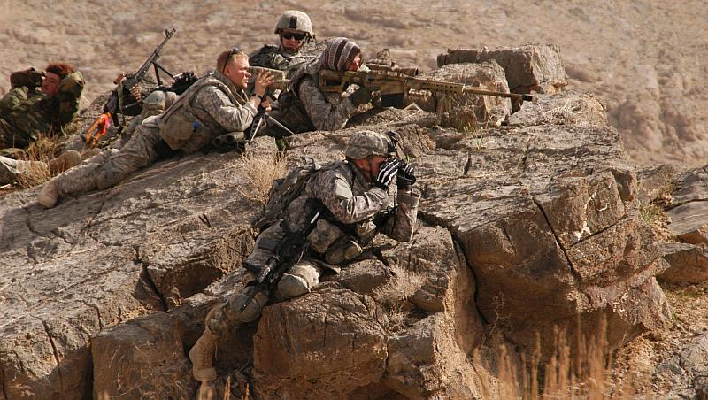
In modern warfare, an overwatch is a small force that takes a position, usually on high ground or atop a building, where it can observe and cover an advancing tactical unit, and provide covering fire when enemy forces are spotted.

Slide 16
Isaiah 62:6-7
"I have posted watchmen on your walls, O Jerusalem; they will never be silent day or night. You who call on the LORD, give yourselves no rest, and give him no rest till he establishes Jerusalem and makes her the praise of the earth.”
Whose spiritual overwatch are you?
Family. Friends. Neighbors. Strangers. People who have no one else.

Slide 17
Thomas Merton was a Trappist monk and one of the most famous writers on spirituality in the 20th century.
Merton tells the story of his awakening and conversion is his best-selling book, The Seven Storey Mountain.
Before he became a Christian, Merton almost died of blood poisoning from an infected wound. At the time he did not believe in God and was so spiritually indifferent, he neither feared nor cared that he would die.

Slide 18
“The worst thing that had ever happened to me was this consummation of my sins in abominable coldness and indifference, even in the presence of death.
“What is more, there was nothing I could do for myself. There was absolutely no means, no natural means within reach, for getting out of that state. Only God could help me. Who prayed for me? One day I shall know. But in the economy of God’s love, it is through the prayers of other men that these graces are given. It was through the prayers of someone who loved God that I was one day, to be delivered out of that hell where I was already confined without knowing it.
—Thomas Merton, The Seven Storey Mountain

Slide 19
Be thankful.
Verse 2: “Continue steadfastly in prayer, being watchful in it with thanksgiving.”
Paul began this letter with a prayer that the Colossians would live the kind of lives that were “fully pleasing” to the Lord. One of the participles Paul uses to describe that kind of life is “giving thanks to the Father” (1:12).
In chapter 3, Paul reminds the Colossians:
Colossians 3:17
And whatever you do, whether in word or deed, do it all in the name of the Lord Jesus, giving thanks to God the Father through him.
So, here, he closes the letter with a reminder to make thanksgiving an essential part of their prayers.

Slide 20
Paul’s word for thanksgiving here, eucharistia, is also one of the names for the Lord’s Supper, “the Eucharist.”
1 Corinthians 11:23-24
“The Lord Jesus, on the night he was betrayed, took bread, and when he had given thanks, he broke it and said, "This is my body, which is for you; do this in remembrance of me."
Knowing that he was just a few hours from going to the cross, our lord still gave a prayer of thanks.

Slide 21
I AM THANKFUL THAT . . .
While on short-term mission trips to places like India, I’ve had children come and put their faces on the ground and touch our feet to beg for money to eat.
I am thankful that my children have never had to do that.
Our shots and the daily mosquito repellent routine.
Malaria.
Meningitis
Hepatitis
Encephalitis
Leprosy
Polio. Laxmi’s 14 year old son Sandeep.
Lack of basic public works and services.
Almost 60% of the urban population and 97% of the rural population are without access to sanitation facilities.
1.5 million pre-school children in India die every year from diarrhea and cholera, dysentery and gastroenteritis from contaminated water are responsible for 60% of the total urban deaths
God’s people have good reason to be thankful in their prayers.

Slide 22
Be helpful.
Verses 3-4: “At the same time, pray also for us, that God may open to us a door for the word, to declare the mystery of Christ, on account of which I am in prison— ⁴ that I may make it clear, which is how I ought to speak.”
Look how often the Apostle Paul asked other people to pray for him and his ministry.
To the Romans he says, “Join me in my struggle by praying to God for me.”
After reminding the Ephesians of the key role that prayer plays in spiritual warfare, he says, “Pray also for me.”
He directs similar requests to the Corinthians, the Philippians, the Thessalonians, and his friend Philemon.

Slide 23
In nine of his thirteen epistles, Paul specifically appeals to his friends and brethren to remember him in prayer.
Though most of them remain nameless to us, the New Testament record suggests there were hundreds, perhaps thousands, of First Century believers who shared in the successes of this preeminent missionary apostle through their prayers.

Slide 24
E.M. Bounds (1835-1913) practiced law for three years until he was called to preach. In his busy life he daily scheduled the hours from four to seven in the morning for prayer. His book Power Through Prayer has become a devotional classic.
“Prayer, to the preacher, is not simply the duty of his profession, a privilege, but it is a necessity. Air is not more necessary to the lungs than prayer is to the preacher. It is an absolute necessity for the preacher to pray. It is an absolute necessity that the preacher be prayed for. These two propositions are wedded into a union which ought never to know divorce: the preacher must pray; the preacher must be prayed for. It will take all the praying he can do, and all the praying he can get done, to meet the fearful responsibilities and gain the largest, truest success in his great work.”

Slide 26
“A Wise Walk and Gracious Talk”
Barry McCarty
Colossians 4:5-6
⁵ Walk in wisdom toward outsiders, making the best use of the time. ⁶ Let your speech always be gracious, seasoned with salt, so that you may know how you ought to answer each person.
Behave like you’re saved.
Make your talk match your walk.

Slide 27
ESV
Final Greetings
⁷ Tychicus will tell you all about my activities. He is a beloved brother and faithful minister and fellow servant in the Lord. ⁸ I have sent him to you for this very purpose, that you may know how we are and that he may encourage your hearts, ⁹ and with him Onesimus, our faithful and beloved brother, who is one of you. They will tell you of everything that has taken place here.
¹⁰ Aristarchus my fellow prisoner greets you, and Mark the cousin of Barnabas (concerning whom you have received instructions—if he comes to you, welcome him), ¹¹ and Jesus who is called Justus. These are the only men of the circumcision among my fellow workers for the kingdom of God, and they have been a comfort to me. ¹² Epaphras, who is one of you, a servant of Christ Jesus, greets you, always struggling on your behalf in his prayers, that you may stand mature and fully assured in all the will of God. ¹³ For I bear him witness that he has worked hard for you and for those in Laodicea and in Hierapolis. 14 Luke the beloved physician greets you, as does Demas.
¹⁵ Give my greetings to the brothers at Laodicea, and to Nympha and the church in her house. ¹⁶ And when this letter has been read among you, have it also read in the church of the Laodiceans; and see that you also read the letter from Laodicea. ¹⁷ And say to Archippus, “See that you fulfill the ministry that you have received in the Lord.”
¹⁸ I, Paul, write this greeting with my own hand. Remember my chains. Grace be with you.
Nestle-Aland Greek NT
⁷ Τὰ κατʼ ἐμὲ πάντα γνωρίσει ὑμῖν Τυχικὸς ὁ ἀγαπητὸς ἀδελφὸς καὶ πιστὸς διάκονος καὶ σύνδουλος ἐν κυρίῳ, ⁸ ὃν ἔπεμψα πρὸς ὑμᾶς εἰς αὐτὸ τοῦτο, ἵνα γνῶτε τὰ περὶ ἡμῶν καὶ παρακαλέσῃ τὰς καρδίας ὑμῶν, ⁹ σὺν Ὀνησίμῳ τῷ πιστῷ καὶ ἀγαπητῷ ἀδελφῷ, ὅς ἐστιν ἐξ ὑμῶν· πάντα ὑμῖν γνωρίσουσιν τὰ ὧδε.
¹⁰ Ἀσπάζεται ὑμᾶς Ἀρίσταρχος ὁ συναιχμάλωτός μου καὶ Μᾶρκος ὁ ἀνεψιὸς Βαρναβᾶ (περὶ οὗ ἐλάβετε ἐντολάς, ἐὰν ἔλθῃ πρὸς ὑμᾶς, δέξασθε αὐτόν) ¹¹ καὶ Ἰησοῦς ὁ λεγόμενος Ἰοῦστος, οἱ ὄντες ἐκ περιτομῆς, οὗτοι μόνοι συνεργοὶ εἰς τὴν βασιλείαν τοῦ θεοῦ, οἵτινες ἐγενήθησάν μοι παρηγορία. ¹² ἀσπάζεται ὑμᾶς Ἐπαφρᾶς ὁ ἐξ ὑμῶν, δοῦλος Χριστοῦ [Ἰησοῦ], πάντοτε ἀγωνιζόμενος ὑπὲρ ὑμῶν ἐν ταῖς προσευχαῖς, ἵνα σταθῆτε τέλειοι καὶ πεπληροφορημένοι ἐν παντὶ θελήματι τοῦ θεοῦ. ¹³ μαρτυρῶ γὰρ αὐτῷ ὅτι ἔχει πολὺν πόνον ὑπὲρ ὑμῶν καὶ τῶν ἐν Λαοδικείᾳ καὶ τῶν ἐν Ἱεραπόλει. ¹⁴ ἀσπάζεται ὑμᾶς Λουκᾶς ὁ ἰατρὸς ὁ ἀγαπητὸς καὶ Δημᾶς.
¹⁵ Ἀσπάσασθε τοὺς ἐν Λαοδικείᾳ ἀδελφοὺς καὶ Νύμφαν καὶ τὴν κατʼ οἶκον αὐτῆς ἐκκλησίαν. ¹⁶ καὶ ὅταν ἀναγνωσθῇ παρʼ ὑμῖν ἡ ἐπιστολή, ποιήσατε ἵνα καὶ ἐν τῇ Λαοδικέων ἐκκλησίᾳ ἀναγνωσθῇ, καὶ τὴν ἐκ Λαοδικείας ἵνα καὶ ὑμεῖς ἀναγνῶτε. ¹⁷ καὶ εἴπατε Ἀρχίππῳ· Βλέπε τὴν διακονίαν ἣν παρέλαβες ἐν κυρίῳ, ἵνα αὐτὴν πληροῖς.
¹⁸ Ὁ ἀσπασμὸς τῇ ἐμῇ χειρὶ Παύλου. μνημονεύετέ μου τῶν δεσμῶν. ἡ χάρις μεθʼ ὑμῶν.

Slide 28
The Letter-bearers

Slide 29
Salutations From Paul’s Companions

Slide 30
Greetings to Believers in Laodicea and Colossae

Slide 31
Paul’s Blessing and Farewell

Slide 32
“I Get by With a Little Help from My Friends”
Barry McCarty
In this seemingly ordinary list of names, Paul’s friends teach us some great lessons on how we can be of service to Christ.

Slide 33
Someone who was dear to Paul
Paul refers to Tychicus and Onesimus each as a “dear brother” and to Luke as his “dear friend.”
Some of the greatest blessings to any Christian are the personal relationships we have with people here at church.
Church is a place to love and be loved. A place to find people who will be dear to us and who treasure us as well.

Slide 34
Someone who had a servant’s heart.
⁷ Tychicus will tell you all the news about me. He is a dear brother, a faithful minister and fellow servant in the Lord. ⁸ I am sending him to you for the express purpose that you may know about our circumstances and that he may encourage your hearts.
In verses 7-11, Paul refers to Tychicus, Onesimus, Aristarchus, Mark, and Justus as “fellow workers.”
Tychicus, who is mentioned five times in the New Testament, was especially helpful to Paul.
He and Aristarchus were representatives from the churches in Asia who accompanied Paul to Jerusalem on his final missionary journey to carry a benevolent offering from the churches in Asia for the poor Christians in Jerusalem.

Slide 35
Tychicus is mentioned here in Colossians because he is actually carrying the letter from Rome to Colossae, along with the letter to the Ephesians.
He was Paul’s “relief pitcher.” From the book of Titus we learn that Paul sent him to relieve Titus in Crete and from 2 Timothy we find that Paul sent him to Ephesus when Timothy was needed elsewhere.

Slide 36
Someone who overcame a sinful past.
⁹ He is coming with Onesimus, our faithful and dear brother, who is one of you.
Onesimus was a runaway slave who had come from Colossae.
He met Paul while Paul was in prison, was converted to Christ, and was now being sent back home as a Christian brother.
The New Testament book to Philemon tells more of his story.
Paul calls a man who was once a runaway slave his “faithful and dear brother.”
Onesimus is one more life that shows when a person comes to Christ, his past is no longer an issue.
His name, Onesimus, means “useful.” Wouldn’t it be nice to have a church full of people named “useful”?

Slide 37
Someone who took great risks.
¹⁰ My fellow prisoner Aristarchus sends you his greetings.
It is possible that Aristarchus was not actually a prisoner, but that he voluntarily made himself Paul’s servant so that he could accompany him and minister to him in prison.
These were dangerous times to be a Christian in the capital, and especially dangerous to be with Paul. Yet Aristarchus risked his life for the sake of his friend and the cause of Christ.
The church needs people who are willing to risk much for the sake of the Gospel.

Slide 38
Someone who got a second chance.
¹⁰ . . . as does Mark, the cousin of Barnabas. (You have received instructions about him; if he comes to you, welcome him.)
Mark had a rough start in the ministry.
He accompanied Paul and Barnabas on their first missionary journey, but deserted them when the going got tough.
On Paul’s second missionary journey, Mark became a source of friction between the two great missionary partners. (Acts 15:37-40)
But by the time Paul writes Colossians, Mark had returned to become one of his greatest helpers.
In 2 Timothy 4:11, Paul even tells Timothy:
Get Mark and bring him with you, because he is helpful to me in my ministry.

Slide 39
Mark was a man who failed in ministry, but who made good on a second chance.
He was not only useful to Paul, but later received a privilege shared by only three other men in history: writing one of the gospels.

Slide 40
Someone who took a stand.
¹¹ Jesus, who is called Justus, also sends greetings. These are the only Jews among my fellow workers for the kingdom of God, and they have proved a comfort to me.
This is the only mention of Jesus who was called Justus in the New Testament. But this much we do know: he was a man who took a stand for Christ.
Paul mentions him as one of his four companions who were “the only Jews among my fellow workers for the kingdom of God” (4:11).
By this time in the life of the church, there was so much persecution from the Jewish leaders that it was often difficult for a Jew to be publicly identified as a Christian leader.
That Jesus Justus was willing to leave his people to stand alongside Paul for Jesus Christ demonstrates great commitment that comforted Paul.

Slide 41
Someone who labored in prayer.
¹² Epaphras, who is one of you and a servant of Christ Jesus, sends greetings. He is always wrestling in prayer for you, that you may stand firm in all the will of God, mature and fully assured. ¹³ I vouch for him that he is working hard for you and for those at Laodicea and Hierapolis.
Epaphras had founded the Colossian church and was most likely its current pastor.
He had traveled to Rome to bring Paul news of the church.
Though apart from them, he continued to minister on their behalf through his prayers.

Slide 42
The word here for “wrestling” is agonizomai, from which we get our English word “agonize.”
The Greeks used it to refer to the pain endured by competitive athletes in the games.
Sometimes we can’t be with people we love. Or, sometimes even when we are with them, there are things we want to do for them that are beyond our powers to do. But we can always minister to them through our prayers.

Slide 43
Someone who was always faithful.
¹⁴ Our dear friend Luke, the doctor, and Demas send greetings.
Luke was Paul’s traveling companion for much of his ministry.
In 2 Timothy 4:11, while still in prison in Rome, Paul mentions that he had sent most of his co-workers on missions to other places, noting “only Luke is with me.”
Because of the Emperor Nero’s brutal persecution of the church, many believers had fled the city of Rome.
Even some of Paul’s co-workers deserted him. But not Luke. He remained faithful, even when doing so put him in great danger.

Slide 44
Someone who was a disappointment.
Luke and Demas are mentioned together both in this passage and in 2 Timothy 4:10, where Paul sadly notes: “Demas, because he loved this world, has deserted me.”
The fact is that there will be people in church who disappoint and desert us.
But remember that when Demas deserted Paul, Luke stayed.

Slide 45
Someone who believed that the Gospel comes with a house key.
¹⁵ Give my greetings to the brothers at Laodicea, and to Nympha and the church in her house.
This is the only mention of Nympha in the NT, a Christian woman living in Laodicea (or perhaps Colossae), in whose house believers gathered for worship.

Slide 47
Someone who had a job to finish.
¹⁷ Tell Archippus: “See to it that you complete the work you have received in the Lord.”
We don’t know what specific work Paul had in mind, but there was something that Archippus had to do that Paul urged him to complete.
Perhaps the most valuable people in church are those who will see things through, who will finish the job, who will finish well.

Slide 48
Someone who had some reading to do.
¹⁶ After this letter has been read to you, see that it is also read in the church of the Laodiceans and that you in turn read the letter from Laodicea.
While Paul’s epistles are letters to people he loved, they are also Holy Scripture preserved through the ages for every believer in every place.
So, whatever else we do with them, we should read and heed.

Slide 50
My Favorite Logos Tools for Text-driven Preaching

Slide 51
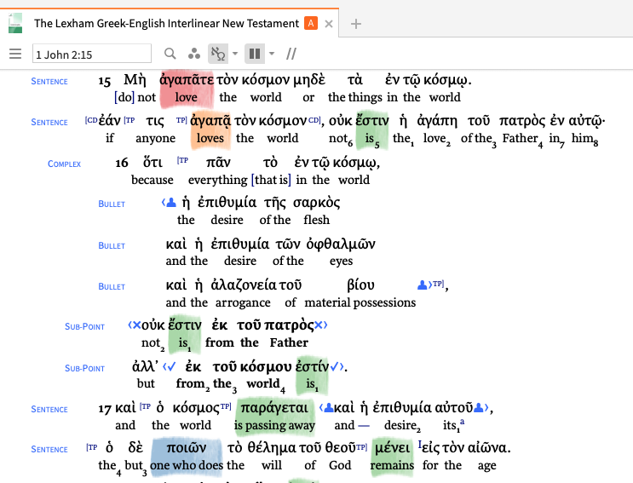
1. Clausal Outlines.
Creating and working with clausal outlines is one of the ways Logos Bible Software excels as a sermon writing tool.

Slide 52
Dean Deppe, The Lexham Clausal Outlines of the New Testament.
If you have this resource, it will be a book in your logos library.

Slide 53
The new and improved way to get clausal outlines: Lexham Discourse Datasets.
Lexham Discourse Datasets are not books in your library, but datasets that enable features within your Logos Bibles.

Slide 54
The Lexham Discourse Datasets can create propositional outlines in most Bibles.

Slide 55
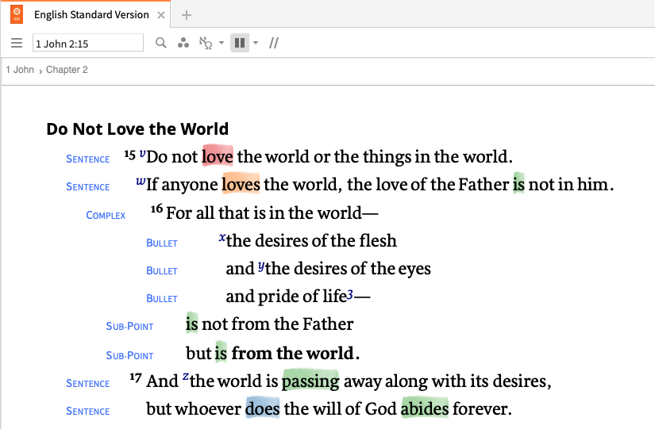

Slide 56
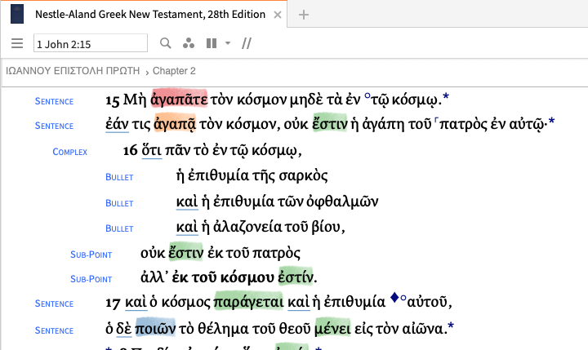

Slide 57
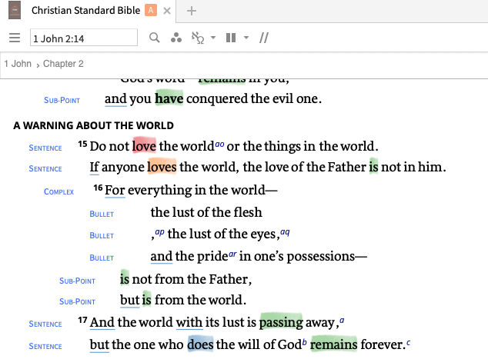

Slide 58
